Slide 1
Group Comparisons (IMT vs Control)

Slide 2
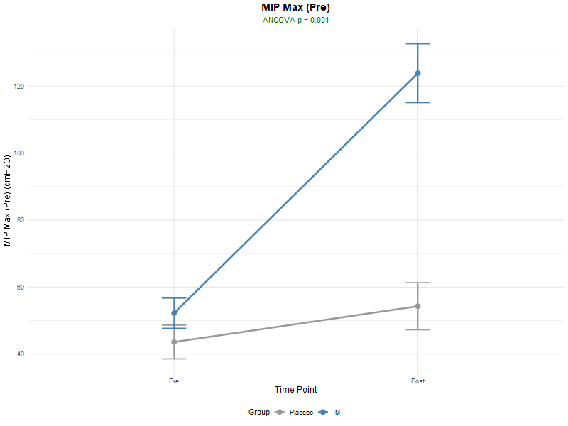
Respiratory
Outcome | Pre | Post | F-Value | P-Value
MIP | 59 | 123.86 | 20.04 | 0.001
SMIP | 274.86 | 371.57 | 6.97 | 0.087
PIF | 3.06 | 5.21 | 10.62 | 0.009
S-Index | 53.14 | 92.29 | 9.31 | 0.01
FIT | 10.94 | 8.5 | 2.23 | 0.827
Volume | 2.49 | 2.39 | 4.6 | 0.901

Slide 3
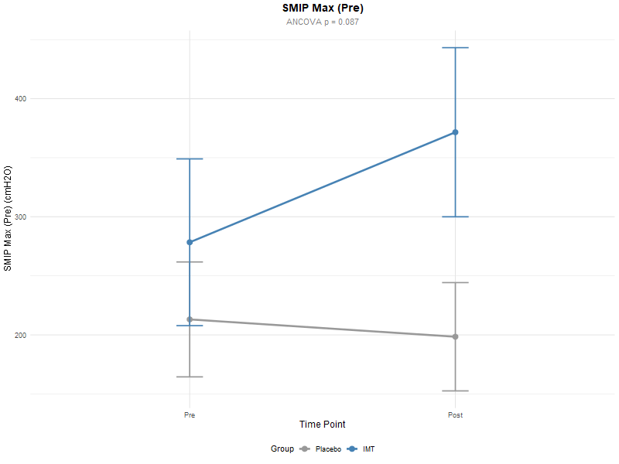
Respiratory
Outcome | Pre | Post | F-Value | P-Value
MIP | 59 | 123.86 | 20.04 | 0.001
SMIP | 274.86 | 371.57 | 6.97 | 0.087
PIF | 3.06 | 5.21 | 10.62 | 0.009
S-Index | 53.14 | 92.29 | 9.31 | 0.01
FIT | 10.94 | 8.5 | 2.23 | 0.827
Volume | 2.49 | 2.39 | 4.6 | 0.901

Slide 4
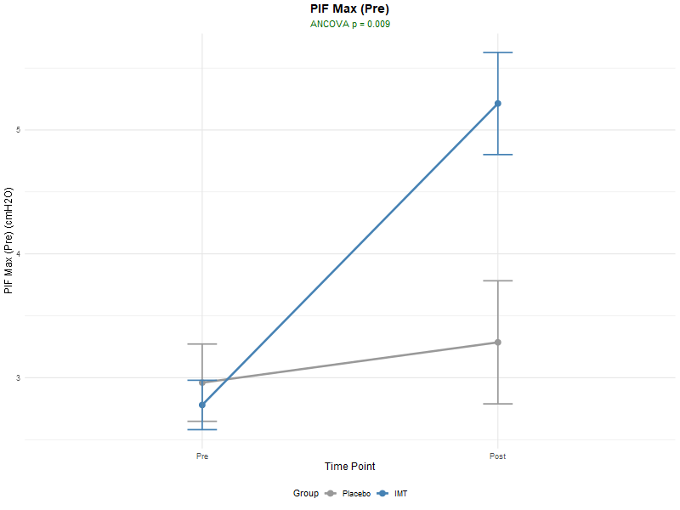
Respiratory
Outcome | Pre | Post | F-Value | P-Value
MIP | 59 | 123.86 | 20.04 | 0.001
SMIP | 274.86 | 371.57 | 6.97 | 0.087
PIF | 3.06 | 5.21 | 10.62 | 0.009
S-Index | 53.14 | 92.29 | 9.31 | 0.01
FIT | 10.94 | 8.5 | 2.23 | 0.827
Volume | 2.49 | 2.39 | 4.6 | 0.901

Slide 5
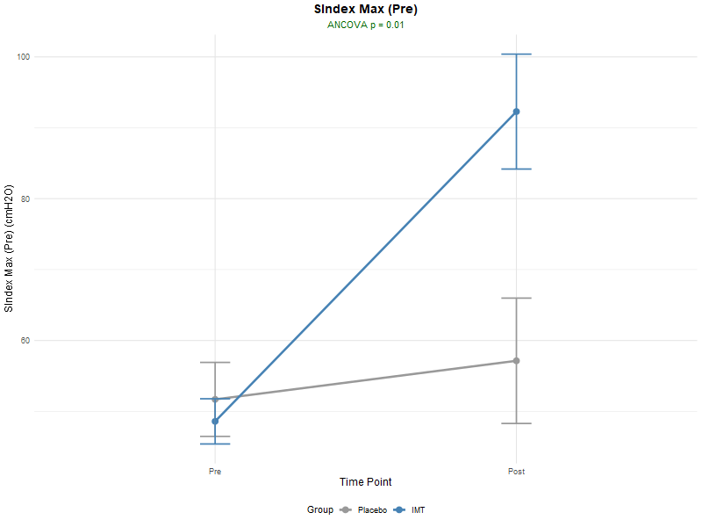
Respiratory
Outcome | Pre | Post | F-Value | P-Value
MIP | 59 | 123.86 | 20.04 | 0.001
SMIP | 274.86 | 371.57 | 6.97 | 0.087
PIF | 3.06 | 5.21 | 10.62 | 0.009
S-Index | 53.14 | 92.29 | 9.31 | 0.01
FIT | 10.94 | 8.5 | 2.23 | 0.827
Volume | 2.49 | 2.39 | 4.6 | 0.901

Slide 6
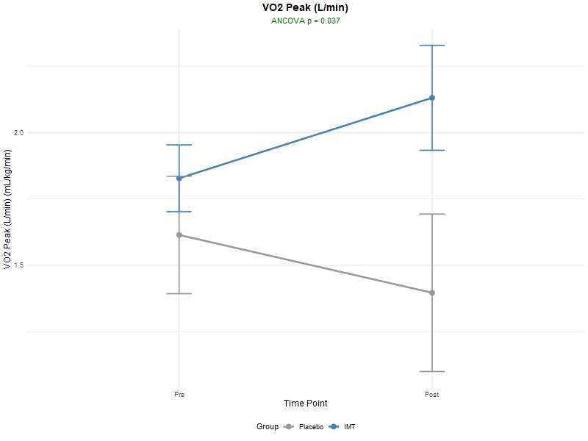
CPET
Outcome | Pre | Post | F-Value | P-Value
VO2 Peak (mL/kig/min) | 24.9 | 28.64 | 22.53 | 0.061
VO2 Peak (L/min) | 1.83 | 2.13 | 26.82 | 0.037
VE/VO2 at Peak | 25.91 | 29.19 | 14.66 | 0.587
VE/VCO2 Slope at Peak | 24.89 | 24.94 | 14.22 | 0.416
VE/VCO2 Slope at VT | 24.94 | 22.02 | 9.33 | 0.114
VE/VCO2 at Peak | 26.92 | 27.87 | 18.15 | 0.121
VE/VCO2 at VT | 27.68 | 28.61 | 16.96 | 0.332
VE | 48.26 | 64.73 | 18.61 | 0.029
Peak Respiratory Rate | 33.57 | 35.78 | 102.93 | 0.336
Peak Tidal Volume | 1.57 | 1.91 | 4.42 | 0.113
Peak O2 Pulse | 11.54 | 13.73 | 7.74 | 0.053
Peak PETCO2 | 34.2 | 34.21 | 13.21 | 0.859

Slide 7
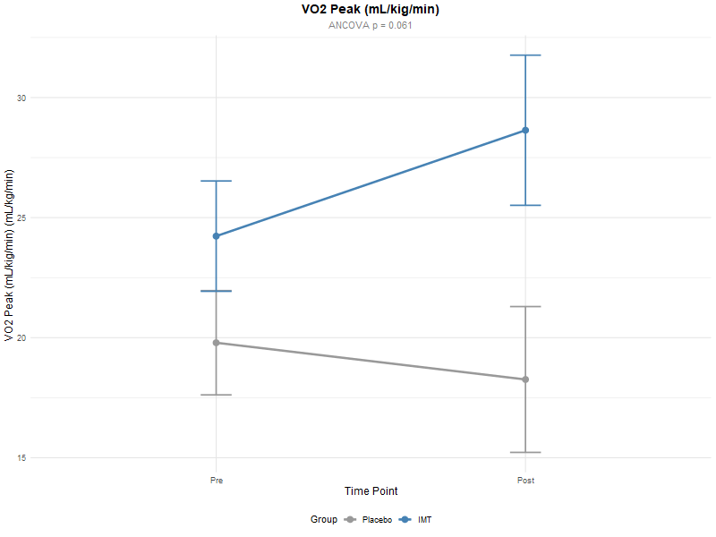
CPET
Outcome | Pre | Post | F-Value | P-Value
VO2 Peak (mL/kig/min) | 24.9 | 28.64 | 22.53 | 0.061
VO2 Peak (L/min) | 1.83 | 2.13 | 26.82 | 0.037
VE/VO2 at Peak | 25.91 | 29.19 | 14.66 | 0.587
VE/VCO2 Slope at Peak | 24.89 | 24.94 | 14.22 | 0.416
VE/VCO2 Slope at VT | 24.94 | 22.02 | 9.33 | 0.114
VE/VCO2 at Peak | 26.92 | 27.87 | 18.15 | 0.121
VE/VCO2 at VT | 27.68 | 28.61 | 16.96 | 0.332
VE | 48.26 | 64.73 | 18.61 | 0.029
Peak Respiratory Rate | 33.57 | 35.78 | 102.93 | 0.336
Peak Tidal Volume | 1.57 | 1.91 | 4.42 | 0.113
Peak O2 Pulse | 11.54 | 13.73 | 7.74 | 0.053
Peak PETCO2 | 34.2 | 34.21 | 13.21 | 0.859

Slide 8
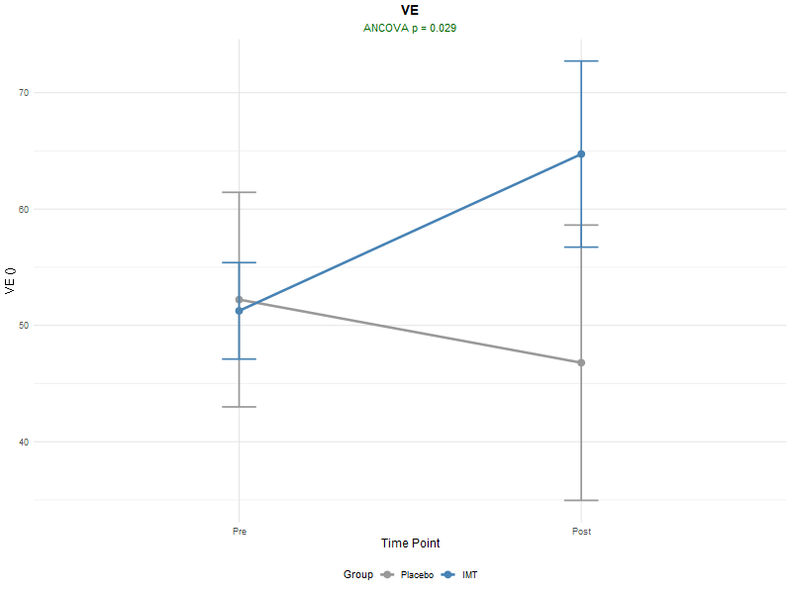
CPET
Outcome | Pre | Post | F-Value | P-Value
VO2 Peak (mL/kig/min) | 24.9 | 28.64 | 22.53 | 0.061
VO2 Peak (L/min) | 1.83 | 2.13 | 26.82 | 0.037
VE/VO2 at Peak | 25.91 | 29.19 | 14.66 | 0.587
VE/VCO2 Slope at Peak | 24.89 | 24.94 | 14.22 | 0.416
VE/VCO2 Slope at VT | 24.94 | 22.02 | 9.33 | 0.114
VE/VCO2 at Peak | 26.92 | 27.87 | 18.15 | 0.121
VE/VCO2 at VT | 27.68 | 28.61 | 16.96 | 0.332
VE | 48.26 | 64.73 | 18.61 | 0.029
Peak Respiratory Rate | 33.57 | 35.78 | 102.93 | 0.336
Peak Tidal Volume | 1.57 | 1.91 | 4.42 | 0.113
Peak O2 Pulse | 11.54 | 13.73 | 7.74 | 0.053
Peak PETCO2 | 34.2 | 34.21 | 13.21 | 0.859

Slide 9
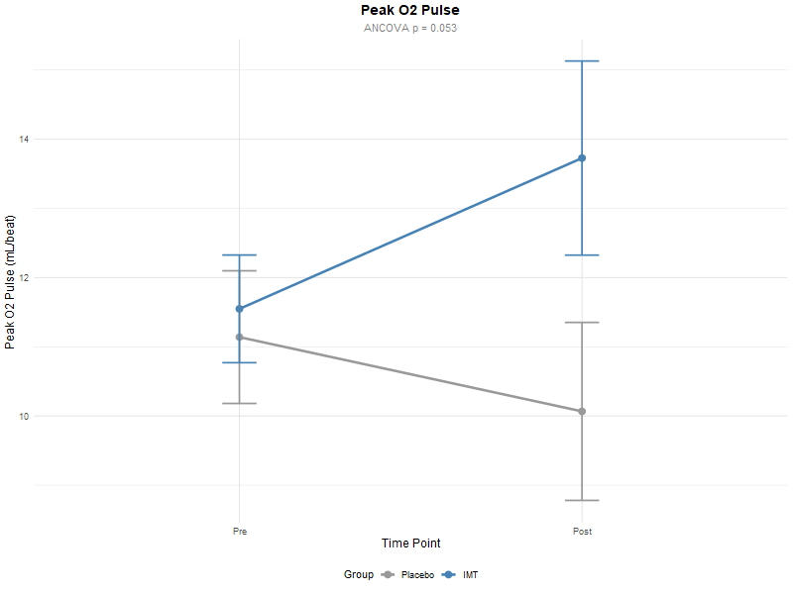
CPET
Outcome | Pre | Post | F-Value | P-Value
VO2 Peak (mL/kig/min) | 24.9 | 28.64 | 22.53 | 0.061
VO2 Peak (L/min) | 1.83 | 2.13 | 26.82 | 0.037
VE/VO2 at Peak | 25.91 | 29.19 | 14.66 | 0.587
VE/VCO2 Slope at Peak | 24.89 | 24.94 | 14.22 | 0.416
VE/VCO2 Slope at VT | 24.94 | 22.02 | 9.33 | 0.114
VE/VCO2 at Peak | 26.92 | 27.87 | 18.15 | 0.121
VE/VCO2 at VT | 27.68 | 28.61 | 16.96 | 0.332
VE | 48.26 | 64.73 | 18.61 | 0.029
Peak Respiratory Rate | 33.57 | 35.78 | 102.93 | 0.336
Peak Tidal Volume | 1.57 | 1.91 | 4.42 | 0.113
Peak O2 Pulse | 11.54 | 13.73 | 7.74 | 0.053
Peak PETCO2 | 34.2 | 34.21 | 13.21 | 0.859

Slide 10
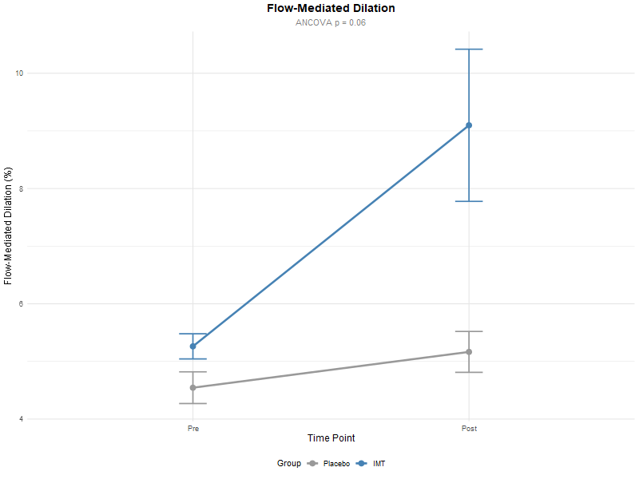
Vascular
Outcome | Pre | Post | F-Value | P-Value
Flow-Mediated Dilation (%) | 5.34 | 9.1 | 4.59 | 0.06
Baseline Shear | 216.33 | 269.19 | 0.04 | 0.895
Maximum Shear | 711.51 | 758.23 | 0.2 | 0.757
Baseline Velocity | 18.99 | 27.71 | 0.09 | 0.781
Maximum Velocity | 62.77 | 74.58 | 0.15 | 0.762
Shear Area to Maximum | 9374.83 | 10094.67 | 1.38 | 0.465
Shear AUC | 18019.74 | 17705.04 | 1.7 | 0.095
Sitting Systolic BP | 111.86 | 114 | 3.65 | 0.81
Sitting Diastolic BP | 72.29 | 70.57 | 6.2 | 0.904

Slide 11
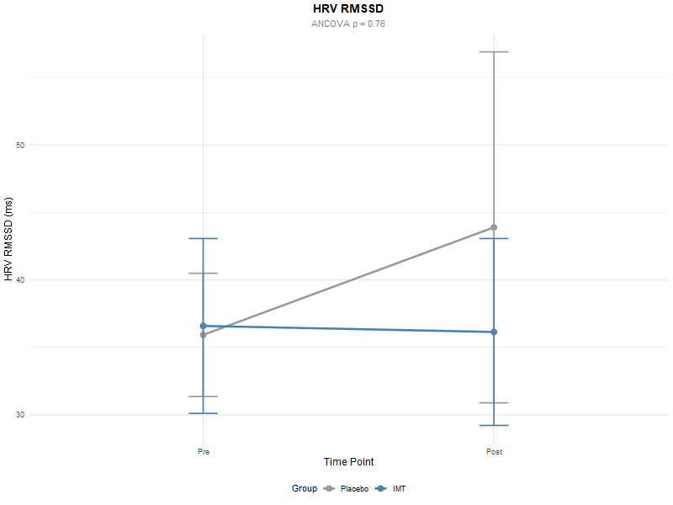
Autonomic
Outcome | Pre | Post | F-Value | P-Value
HRV SDNN | 51.44 | 50.07 | 3.49 | 0.834
HRV RMSSD | 35.27 | 36.14 | 3.14 | 0.76
Heart Rate | 69.06 | 69.61 | 11.22 | 0.308
HRV LF/HF Ratio | 1.2 | 0.93 | 0.68 | 0.292
HRR 1 | 28 | 17.57 | 1.66 | 0.878
HRR 2 | 41.43 | 32.14 | 3.91 | 0.61
Chronotropic Index (CI) | 0.82 | 0.79 | 1.45 | 0.668

Slide 12
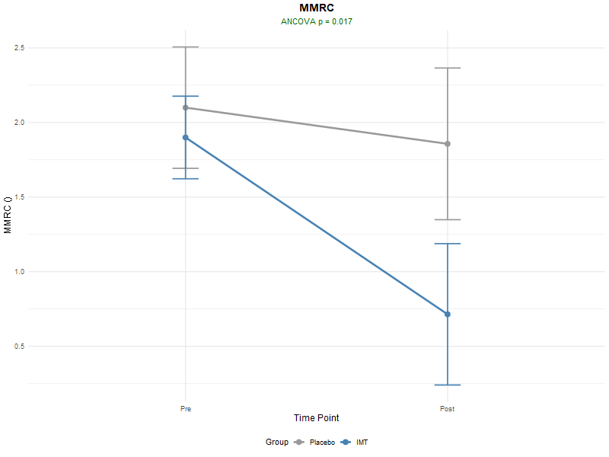
Dyspnea
Outcome | Pre | Post | F-Value | P-Value
MMRC | 2 | 0.71 | 22.68 | 0.017

Slide 13
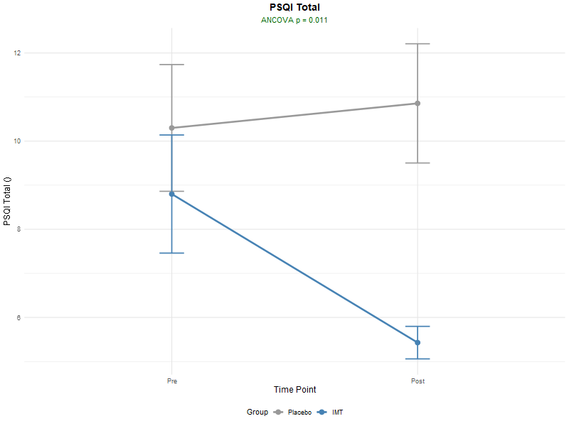
Sleep
Outcome | Pre | Post | F-Value | P-Value
PSQI Total | 7 | 5.43 | 33.65 | 0.011

Slide 14
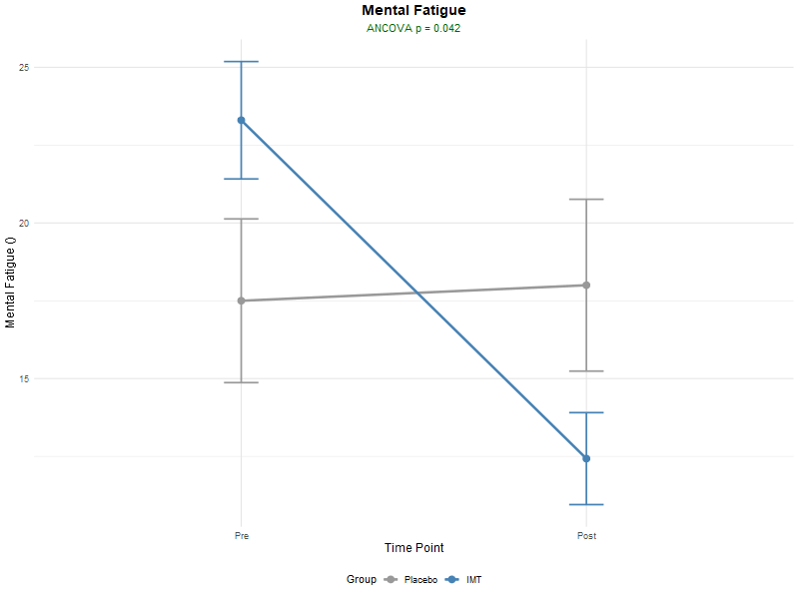
Brain Fog
Outcome | Pre | Post | F-Value | P-Value
Woods Mental Fatigue Inventory | 21.86 | 12.43 | 4.29 | 0.042

Slide 15
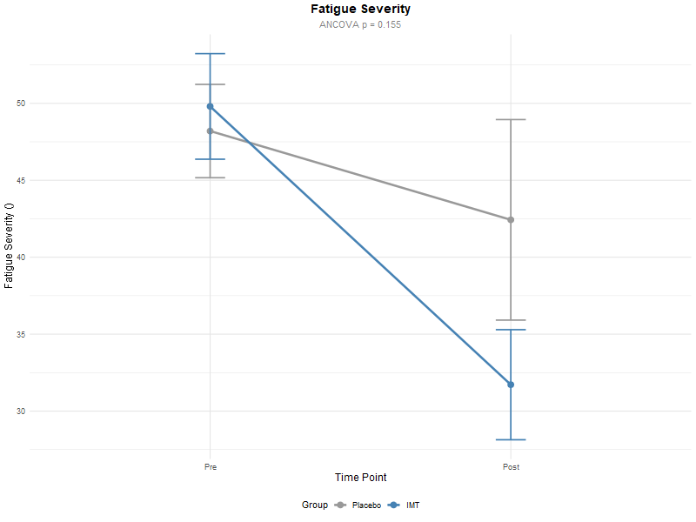
Fatigue
Outcome | Pre | Post | F-Value | P-Value
Fatigue Severity | 48.29 | 31.71 | 5.68 | 0.155
Visual Analogue Scale (VAS) | 4.57 | 1.29 | 6.64 | 0.005
Post-Exertional Malaise (DSQ) | 21.43 | 12.86 | 12.16 | 0.039

Slide 16
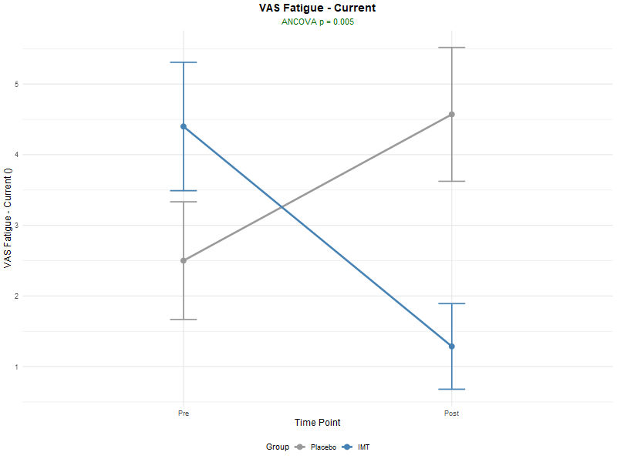
Fatigue
Outcome | Pre | Post | F-Value | P-Value
Fatigue Severity | 48.29 | 31.71 | 5.68 | 0.155
Visual Analogue Scale (VAS) | 4.57 | 1.29 | 6.64 | 0.005
Post-Exertional Malaise (DSQ) | 21.43 | 12.86 | 12.16 | 0.039

Slide 17
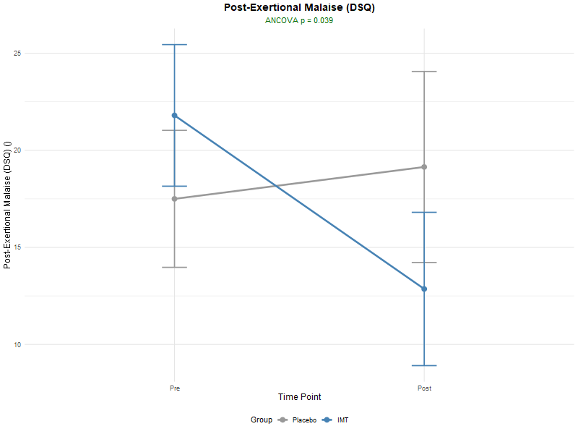
Fatigue
Outcome | Pre | Post | F-Value | P-Value
Fatigue Severity | 48.29 | 31.71 | 5.68 | 0.155
Visual Analogue Scale (VAS) | 4.57 | 1.29 | 6.64 | 0.005
Post-Exertional Malaise (DSQ) | 21.43 | 12.86 | 12.16 | 0.039

Slide 18
Mediation

Slide 19
Fatigue
Outcome | Beta | CI | p-Value
MIP (cmH2O) | -5.2 | (-11.1, -0.2) | 0.042
Percent of Predicted MIP (%) | -6.3 | (-12.7, -0.63) | 0.024
Respiratory
Time
Fatigue

Slide 20
Brain Fog
Outcome | Beta | CI | p-Value
MIP (cmH2O) | -2.9 | (-6.6, -0.0 | 0.042
Percent of Predicted MIP (%) | -3.7 | (-7.7, -0.2) | 0.042
Respiratory
Time
Brain Fog

Slide 21
VO2Max
Outcome | Beta | CI | p-Value
MIP (cmH2O) | 0.35 | (0.2, -0.56 | < 0.001
Percent of Predicted MIP (%) | 0.36 | (0.2, 0.6) | < 0.001
Respiratory
Time
VO2Max

Slide 22
FMD
Outcome | Beta | CI | p-Value
MIP (cmH2O) | 0.88 | (0.04, -2.0 | 0.06
Percent of Predicted MIP (%) | 1.5 | (0.3, 2.7) | 0.004
Respiratory
Time
FMD

